Slide 1


Accessibility On Demand™
Solution Overview
THE 1ST TRULY AUTOMATED PDF REMEDIATION SERVICE
October 22, 2025

Slide 2
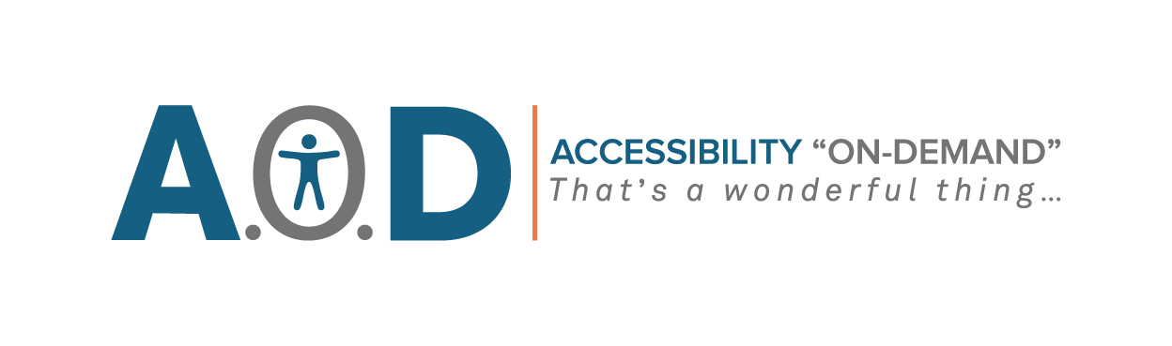

Today's Objective
Session Takeaway
Learn how current practices and processes are not a viable or scalable solution
Understand what ADA Title II is and what it means for school districts, public education, and universities
Understand how AoD™ can either complement or integrate with your business processes or technology stack
See why 90% of PDFs remain inaccessible—and what it takes to remain compliant
Learn how Accessibility on Demand™ solves the accessibility gap for a fraction of the cost
©2025 Proprietary and Confidential. All Rights Reserved.

Slide 3
358 Million
Worldwide live with moderate-to-severe vision loss, every one a possible assistive-reader user¹.
Did You Know?
1 (Statista, 2024)
17.5 Million
Children worldwide live with moderate-to-severe vision loss², every one a possible screen reader user.
2 (Lancet Global Health, 2021)
With ~110 million children worldwide likely needing, or would significantly benefit from, assistive readers.
©2025 Proprietary and Confidential. All Rights Reserved.

Slide 4
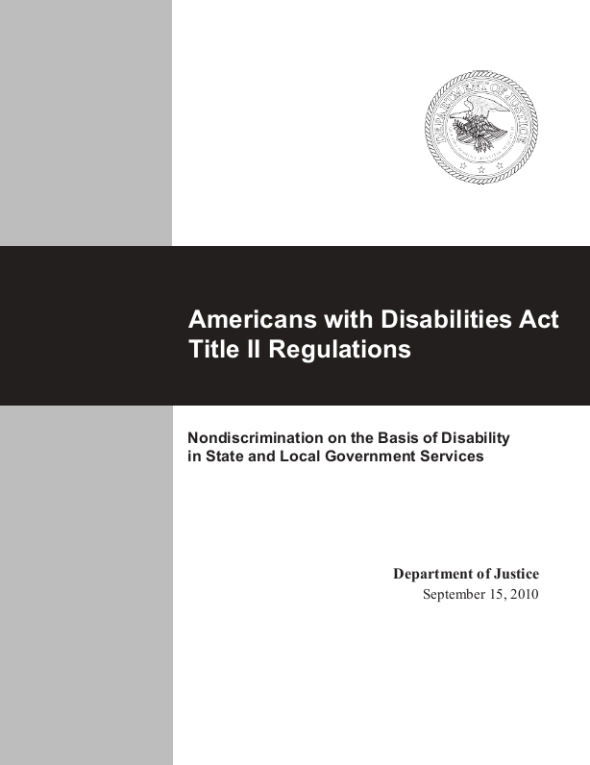
What is ADA Title II?
And what does that mean for my district?
ADA Title II Final Rule is in effect for state/local governments, including Public K-12, Community Colleges, & Public Universities
All “Web Content,” including websites, mobile apps, and documents, must be made accessible against the standards of the Web Content Accessibility Guidelines (WCAG) Level 2.1 AA and PDF/UA for PDF Documents
ADA Title II was put in place to ensure equal access to all public content regardless of ability
This is not just for websites, but for all public documents published or created by the district, school, teacher, athletic director, or employee
©2025 Proprietary and Confidential. All Rights Reserved.

Slide 5


When is the Deadline?
And who is enforcing these mandates?
Compliance Deadlines are determined by the population of the city or county the school district resides in:
  0 - 49,999 persons: April 26, 2027
  50,000 or more persons: April 24, 2026
ADA Title II for the education sector is enforced by the Department of Education - Office for Civil Rights (OCR) and the Department of Justice (DOJ)
There are two major repercussions for non-compliance:
  Private lawsuits averaging between $100,000 - $150,000 per instance
  Withheld State & Federal Funding until full compliance is reached
©2025 Proprietary and Confidential. All Rights Reserved.
Notes:
Released originally in 2011.

Slide 6

What Needs to be Accessible?
Any document a student, parent, guardian, staff member, or community member must access to participate in or benefit from educational programs, services, or activities must be accessible.
Note: Just because your website is ADA Accessible, doesn’t mean your documents are!
Including:
  All PDF online, distributed via email, or required for compliance, enrollment, instruction, or participation.
  Newsletters, Flyers, District or School Communication
  Forms, Policies, Board Minutes, Lesson Plans
  Syllabuses & Course Material
  Homework Assignments
©2025 Proprietary and Confidential. All Rights Reserved.

Slide 7

What is “Archived Web Content?”
According to ADA Title II, Archived Web Content means:
The content “was created before the date the public entity is required to comply with (ADA Title II)”
“Is retained exclusively for reference, research, or recordkeeping;”
“Is not altered or updated after the date of archiving; and”
Is organized and stored in a dedicated area or areas clearly identified as being archived.”
The piece of content must meet all four requirements to be considered “archived.”
Section 35.104 Definitions under ADA Title II Regulations
©2025 Proprietary and Confidential. All Rights Reserved.

Slide 8
There’s a HUGE GAP in PDF Accessibility
PDFs Compliant
Major Deadlines
10%
April 2026/27
(Adobe, 2024)
(ADA Title II, DOJ)
Under ADA Title II and Section 508, every public-facing PDF must be accessible to people with disabilities. But the reality?
Fines & Lawsuits Paid Annually
$1,000,000,000+
But the numbers show: almost no one is ready.
©2025 Proprietary and Confidential. All Rights Reserved.

Slide 9

Section 2
PDF Accessibility Challenges
RULES ARE CLEAR — REMEDIATION ISN’T.
©2025 Proprietary and Confidential. All Rights Reserved.

Slide 10



Understanding PDF Accessibility Standards
WCAG (2.1 AA)
PDF/UA
Government Standards Met
Global baseline for Accessible Digital Content
The How-To Guide for Accessible PDFs
EN 301 549 / EAA (European Union)
Section 508 (US Federal)
ADA Title II & III (US State/Local & Education)
AODA (Ontario, CA)
Accessible Canada Act (ACA - Federal)
UK PBSAR / Equality Act (UK) and others...
Why it matters: almost every country’s law references WCAG—meet it and you’re covered worldwide. WCAG 2.1 AA is explicitly called out in ADA Title II Regulations as the standard.
Why it matters: PDF-specific rules to meet WCAG; the clearest path to provable compliance.
©2025 Proprietary and Confidential. All Rights Reserved.

Slide 11



Six Manual Steps—Multiplied by Every Page
Best-in-class tools can automate ±30 % of this, but a specialist must still verify every step
Manual Step #1
Manual Step #2
Manual Step #3
Manual Step #4
Manual Step #5
Manual Step #6
Prep & Proof OCR
Tag Structure
Set Reading Order
Write Alt Text
Fix All Tables/Forms
Validate & Retest
Manually clean scanned text before real work starts.
Classify hundreds of content elements by hand.
Drag & drop items to guess logical flow.
Describe every image or chart—one thoughtful sentence at a time.
Senior experts decode headers, scopes, tab order.
Run checker, then manual screen‑reader test—repeat till pass.
DO THE MATH...
Each step × 1,000 pages = 250-person hours… before QA.

Slide 12




BOTTOM LINE
Manual Remediation Doesn't Scale
SLOW
EXPENSIVE
INCONSISTENT
UNMANAGEABLE
15-30+ Min/Page (Industry Estimate)
Cripples deadlines; large projects take months or years (e.g., 1M pages ≈ 9-19 staff-years).
$8-$25 + /page
Financially impractical at scale; costs quickly escalate ($50k- $ 250k+ per 10k pages).
30% Error Rate
Different remediators, different results — audits still fail.
Trillions of PDFs (Adobe)
Millions of backlog pages keep growing faster than humans can clear them.
Manual effort (even with tools) offers only incremental savings, not transformation. Automation IS NEEDED to break the bottleneck..
Notes:
If you had a 150 page annual budget document, it would take about 4 weeks to make that PDF accessible based on one person working 8 hours a day. Based on the Missouri National Education Association and what they deem the average teacher salary, that four weeks would cost the district just over $4,000 in wages (not including benefits, taxes, etc.). For complicated charts, tables, and graphs, the cost per page goes up to $100+ dollars.
All of this for a compliance score that has an average of a 30% error rate. For context, AoD would be able to make that document over 95% Compliant in less than one minute for $288.

Slide 13

Section 3
Current Market Conditions
©2025 Proprietary and Confidential. All Rights Reserved.

Slide 14
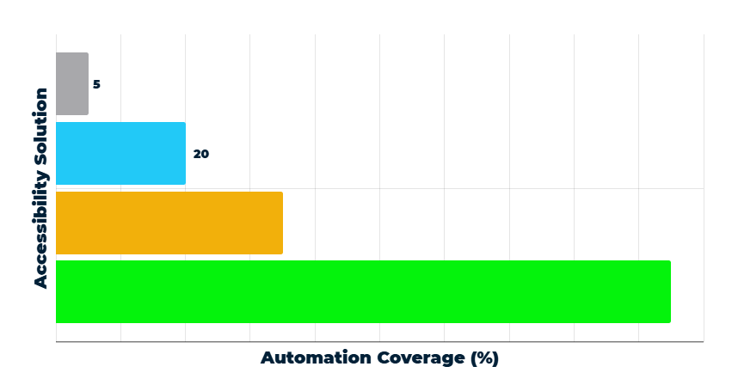
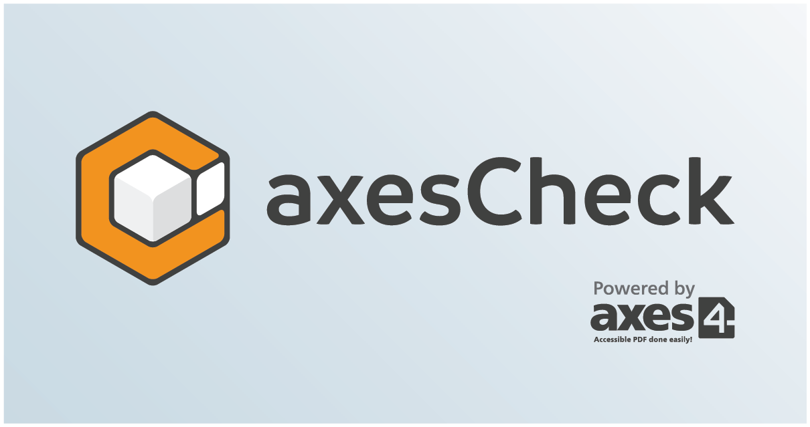



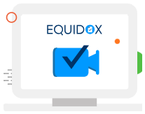

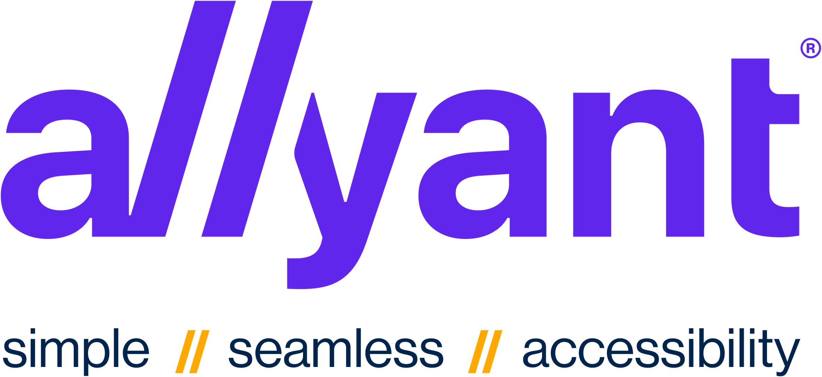


% of Accessibility Process Automated: AoD™ vs. Other Tools
~35%
LEGACY AUTOMATION
35
95%
Accessibility On Demand™
95
AOD™ AUTOMATION
EVEN BEST-IN-CLASS TOOLS AUTOMATE ONLY ~35% OF THE PROCESS. LEAVING THE MAJORITY RELIANT ON COSTLY SPECIALISTS —UNTIL AOD™
©2025 Proprietary and Confidential. All Rights Reserved.

Slide 15

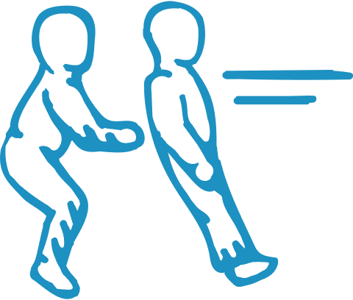


Why the Shortfall?
+
+
=
Automation Gap
Reliability Gap
Usability Gap
Scalability & Cost Shortfall
Manual clicks still drive the workflow; genuine end-to-end automation is missing.
Inconsistent tagging & weak checkers mean audits fail—files bounce back for costly do-overs.
Tools require specialized skill sets so adoption stalls, queues grow, payroll balloons.
When any gap remains, per-page labor stays high and high-volume compliance becomes financially impossible.
AoD™ closes these core gaps—delivering fully automated, cost-efficient, and verifiable accessibility at scale.

Slide 16

Section 4
Accessibility on Demand™
©2025 Proprietary and Confidential. All Rights Reserved.

Slide 17

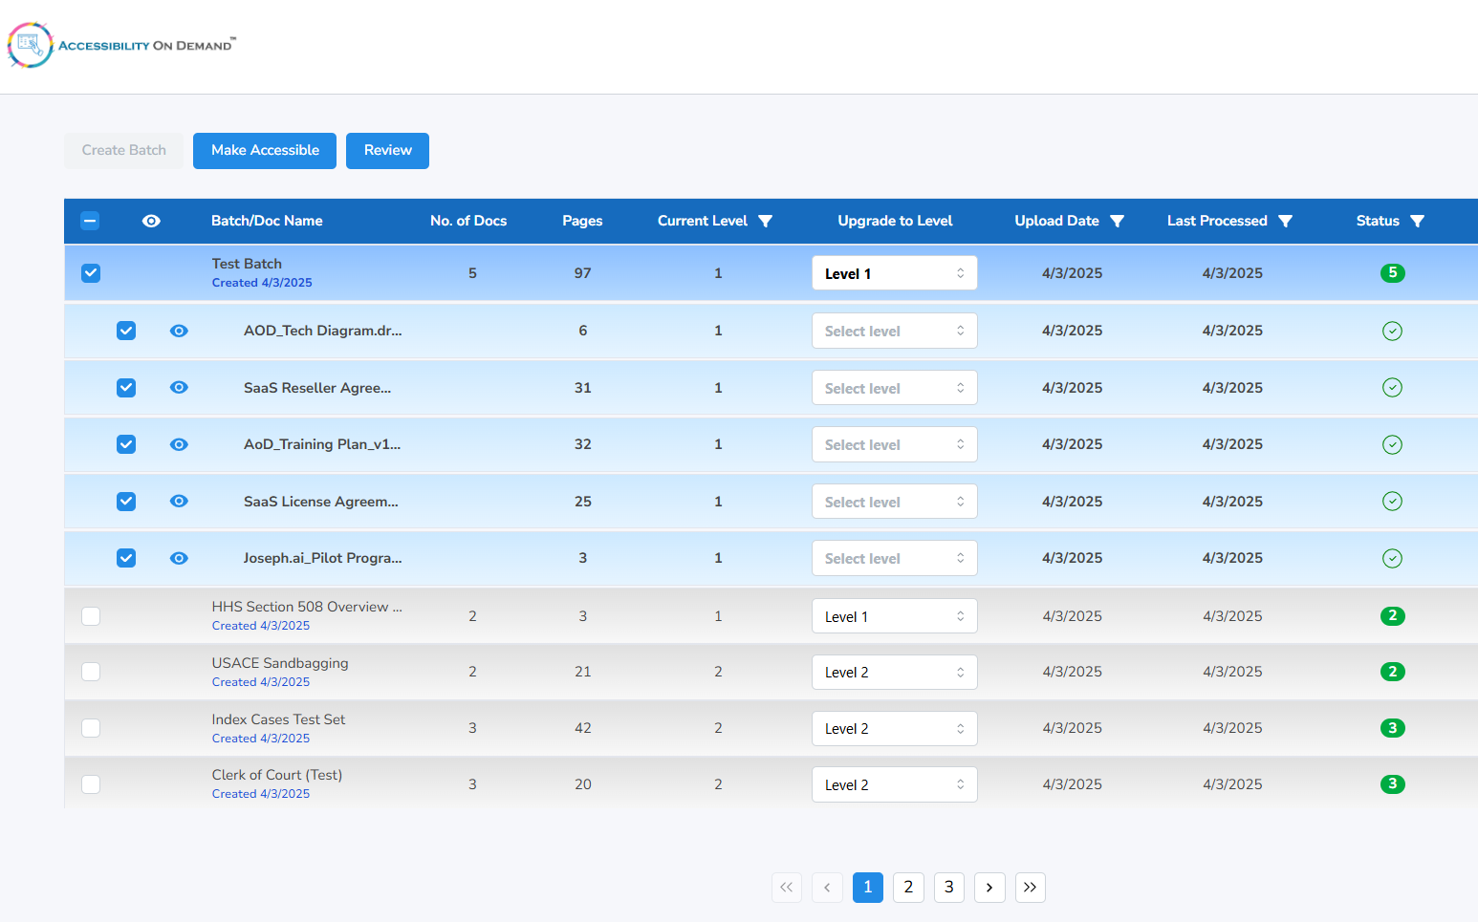
Accessibility on Demand™
The First Truly Automated PDF Remediation Platform
Dramatically Lower Cost & Increase Scale
  Processes bulk pages in seconds; enables margins competitors can't match and remediates documents in parallel
Highly-Effective & Scalable Compliance
  95 %+ or 99+% compliance score options, with auditable proof.
No Expertise Required
  Intuitive workflow allows anyone to run jobs; experts focus only when needed
©2025 Proprietary and Confidential. All Rights Reserved.

Slide 18





How AoD™ Removes Accessibility Roadblocks
+
+
=
Trusted Text Accuracy
AI-Driven Structure & Meaning
True On-Demand Scale
Audit-Ready Compliance
The Edge
  Advanced OCR + image cleanup captures every word, even on rough scans.
Client Benefit
  No more retyping or manual proofing—your team starts with rock‑solid text.
The Edge
  AI auto‑tags headings, tables, reading order, and creates context‑aware alt‑text.
Client Benefit
  95%+ of hand-tagging disappears; screen-reader users get rich detail.
The Edge
  Parallel engine processes thousands of files simultaneously.
Client Benefit
  Hit overnight deadlines; clear multi-year backlogs—no new hires.
The Edge
  Built-in checks validate against WCAG 2.1 AA & PDF/UA (PAC logic); provides verifiable proof.
Client Benefit
  Ends audit anxiety with predictable, verifiable results, fueling repeat business.
©2025 Proprietary and Confidential. All Rights Reserved.

Slide 19


Real‑World Results
An Impossible Deadline & Budget Made Possible with AoD™
A government agency needed 25,000 public records accessible in 5 days.
Metric
Manual Plan
With AoD™
Time to Deliver
Weeks to Months
< 1 Day
Cost
$250,000
$5,000
AOD™ delivered what dozens of contractors and $250,000 couldn’t.
©2025 Proprietary and Confidential. All Rights Reserved.

Slide 20
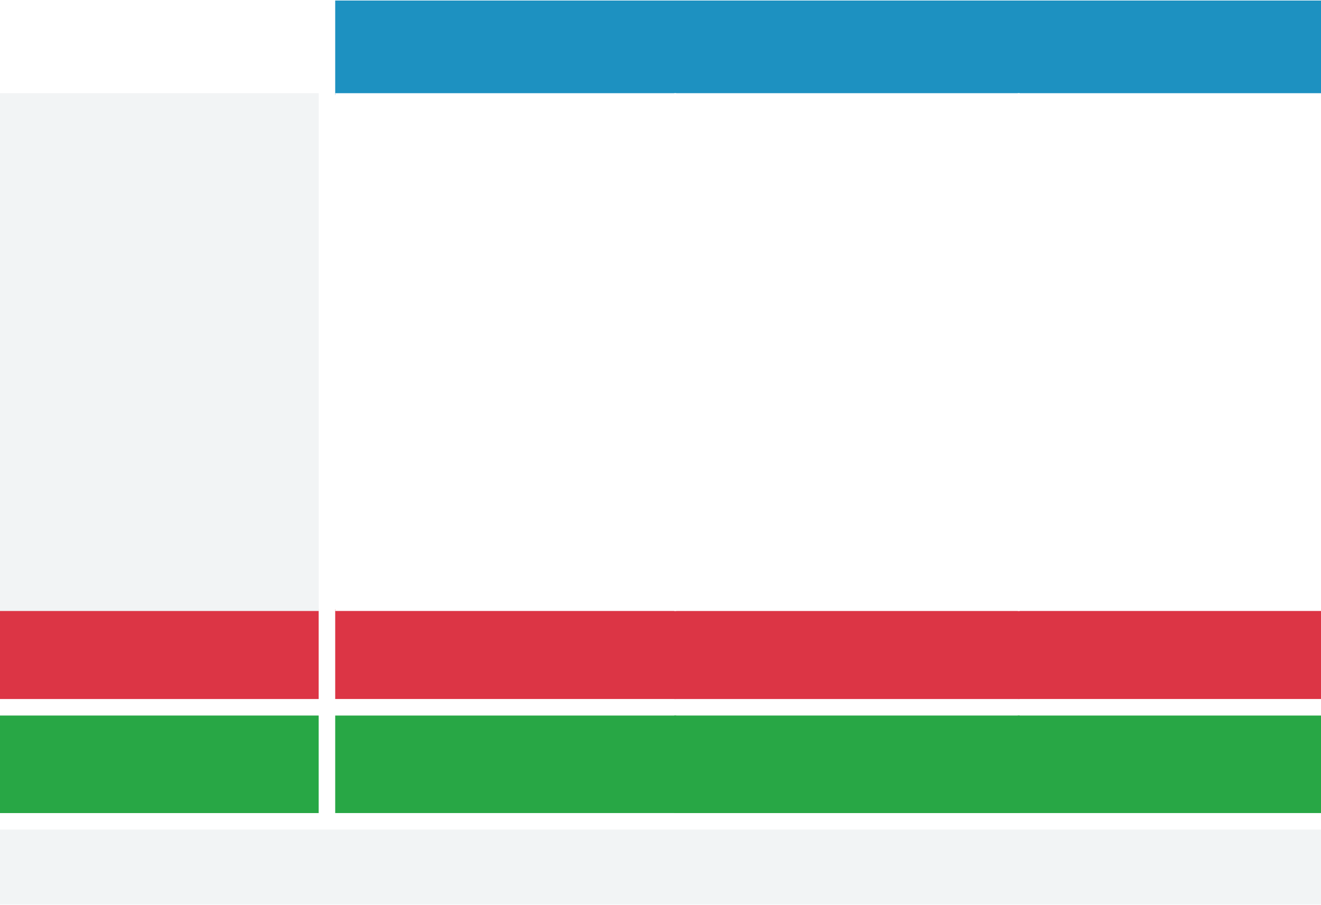


All levels include: Language tagging, document metadata, logical bookmarks, batch processing at scale.
Level 1 (Standard)
Level 2 (Enhanced)
Level 3 (Full)
Searchable PDFs
Tag Structure & Reading Order
Image Descriptions / Alt Text
Basic Alt Text for Every Image
Contextual Alt Text for Every Image
Expert Verified & Custom
Flexible Service Levels for Every Need
Expert Human Review & Fixes
-
-
WCAG & PDF/UA Compliance Score**
Typically 95%+
95%+ Compliance Score
99%+ Compliance Score
Best For
Text-Heavy Docs
Image & Chart Heavy Docs
Policy-Driven Docs
Turnaround
Seconds
Minutes
Fast SLA (Hours)
Market Price
~$8-$15
~$15-$100
$100+
AoD™ Price
$0.32
$1.92
$12.80
** Compliance score - calculated assessing passes/warnings against all checks via industry leading compliance checker
AOD™ costs 95% less than the market average.
Statewide Contract Number: MS250263001
©2025 Proprietary and Confidential. All Rights Reserved.

Slide 21
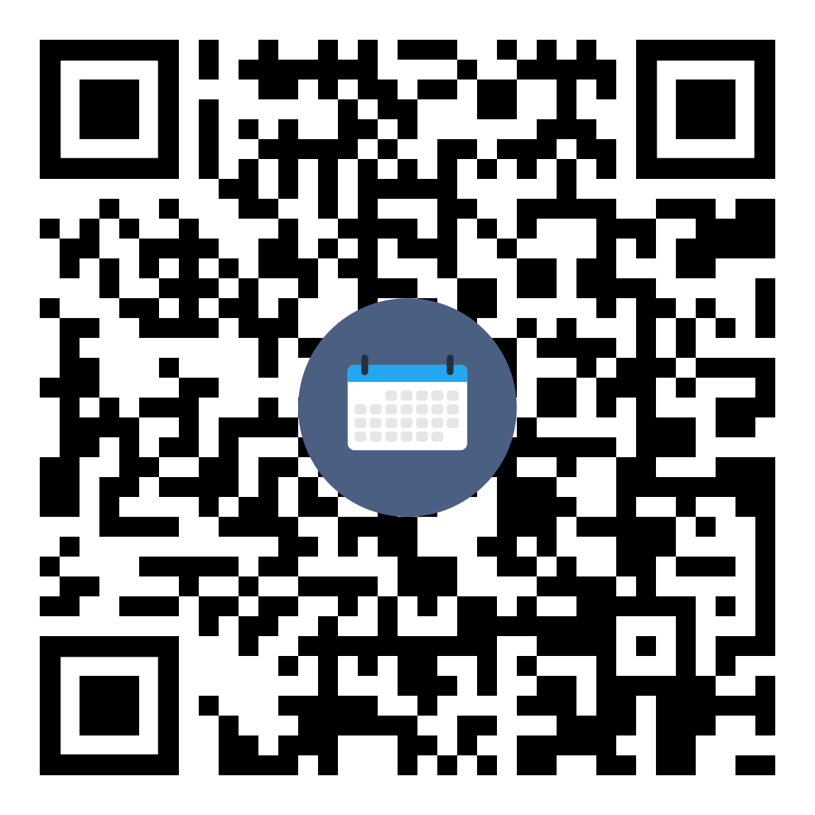
Thank You!
Brock Fuemmeler
President
IMS Technology Group
Email: BrockF@IMSSecure.com
Phone: (573) 298-4006
IMSTechnologyGroup.com/AOD-MO
Schedule an AoD Demo for Your District

