Slide 1


MARE/MO K-8 CONFERENCE
General Session

Slide 2

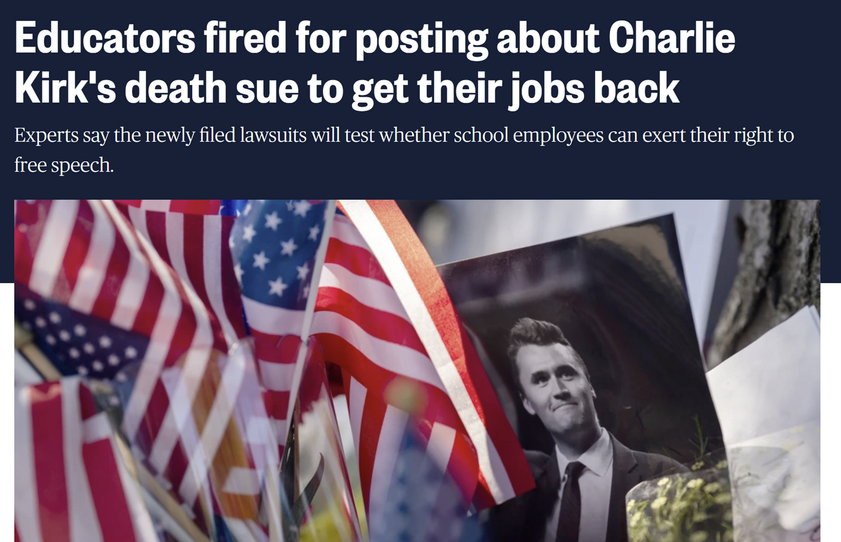
STAFF MEMBER
FREE SPEECH

Slide 3

ROADMAP OF
RELEVANT CASE LAW
Pickering standard sets the bar
Private Citizen + matter of public concern
Garcetti standard sets the “at work” standard
Speech made pursuant to official duties is different
Kennedy clarifies free speech
What do we tolerate from others while “on the clock”?
Content restrictions?

Slide 4
THE FACTS OF
AN INCIDENT MATTER
Scenario
During a mandatory teacher professional development meeting, a high school teacher interrupts the session to denounce the district’s new equity training, calling it “a waste of time” and “political nonsense.” The teacher then sends a follow-up email to all staff criticizing the superintendent’s leadership and urging others to “refuse to comply.”

Slide 5
THE FACTS OF
AN INCIDENT MATTER
Scenario
An elementary teacher attended a No Kings demonstration last Saturday. During the demonstration, the teacher stepped onto the podium, grabbed the bullhorn, and yelled loudly at counter-protestors “Go home racists!”. This was captured on video and played on the local news, and you have received emails from a few community members about the coverage.

Slide 6
THE FACTS OF
AN INCIDENT MATTER
Scenario
During a middle school science class, as the class is learning about weather patterns, your teacher tells the class, “Climate change deniers are destroying the world. And people like farmers are still voting for politicians who aren’t doing anything to stop climate change.” The teacher gets off track and shows a video to the class where a youtuber is interviewing people on the streets about climate change and mocking their responses.

Slide 7
THE FACTS OF
AN INCIDENT MATTER
Scenario
During a middle school science class, as the class is learning about weather patterns, your teacher tells the class, “Climate change deniers are destroying the world. And people like farmers are still voting for politicians who aren’t doing anything to stop climate change.” The teacher gets off track and shows a video to the class where a youtuber is interviewing people on the streets about climate change and mocking their responses.

Slide 8
THE FACTS OF
AN INCIDENT MATTER
Scenario
A high school teacher maintains a personal TikTok account. The videos are not done on school time or using a school device, but are public, and have garnered the attention of many students recently because on the account, she has a “Classroom Nonsense” series about why teachers are leaving the profession.
While none of these stories identify specific parents or students, you have received complaints from some parents that they feel like students cannot “be themselves” in her classroom out of fear that they may become a subject of the latest video. The teacher, when asked about the account, claims that these are all stories that have been submitted to her by other teachers, from other schools.

Slide 9
STUDENT-INITIATED NON-CURRICULAR GROUPS

Slide 10

PROVIDING EQUAL ACCESS &
AVOIDING DISTRICT SPONSORSHIP
Must be student-initiated
Use the process in your policies for this
Must be student-led
Staff member can supervise only
The District can place time, place, and manner restrictions
Not disruptive to school time, school events or activities
Publication and support must be equal and consistent
Announcements
Posters
Yearbook

Slide 11
THE BOARD’S ROLE IN STAFF &
STUDENT DISCIPLINE

Slide 12

“DUE PROCESS” &
ADMINISTRATION
Administrators serve as the first line of investigation and due process for staff and student matters
Only some matters would ever come before the Board per policy and law
Contracted employees
Discipline of more than 10 days OSS
Precedent setting when the Board hears matters not reserved for the Board
“Due Process” and the Board of Education
The Board must sit as a neutral fact-finder and decision-maker
No preconceived decision or determinations
Difficult when matters are “out there” in the public

Slide 13
“DUE PROCESS” & THE
BOARD OF EDUCATION
The Board must sit as a neutral fact-finder and decision-maker
No preconceived decision or determinations
Difficult when matters are “out there” in the public

Slide 14
SUNSHINE LAW

Slide 15
SUNSHINE LAW
UPDATES IN THE SUNSHINE LAW
HB 145 was signed by the Governor on July 14, 2025, modifying certain provisions of the Missouri Sunshine Law.
It went into effect on August 28, 2025.
Changes were made to § 610.021, RSMo., which is the statute that allows for closure of certain records; however, the changes likely won’t affect schools (endangered plants, personal information of campers, etc.).
Changes were also made to § 610.026, RSMo., though, related to how public governmental bodies respond to Sunshine Law Requests.

Slide 16
SUNSHINE LAW
REQUIRING PAYMENT
The new language allows public bodies (including school districts) to charge fees up front, prior to fulfilling Sunshine Law Requests.
Requests will be considered withdrawn if the requestor fails to remit all fees within 90 days, or within 150 days if the requested fees are greater than $1k. This includes responses where clarification is requested.
The clock starts ticking as of the day the requestor is made aware of the charge.

Slide 17
SUNSHINE LAW
REQUIRING PAYMENT
Notice must be made to the requestor that they have to pay within the time limits or the request will be considered withdrawn.
If the request is considered withdrawn, and then a substantially similar or same request is made, the initial fee, plus any subsequent fee necessary to fulfill the request may be charged to the requestor.
Any pending requests for records as of August 28, 2025 will be considered withdrawn if the fees aren’t paid by January 1, 2026.
The new requirements do not apply if a lawsuit has been filed against the public body with regard to the records that are subject to the request.

Slide 18
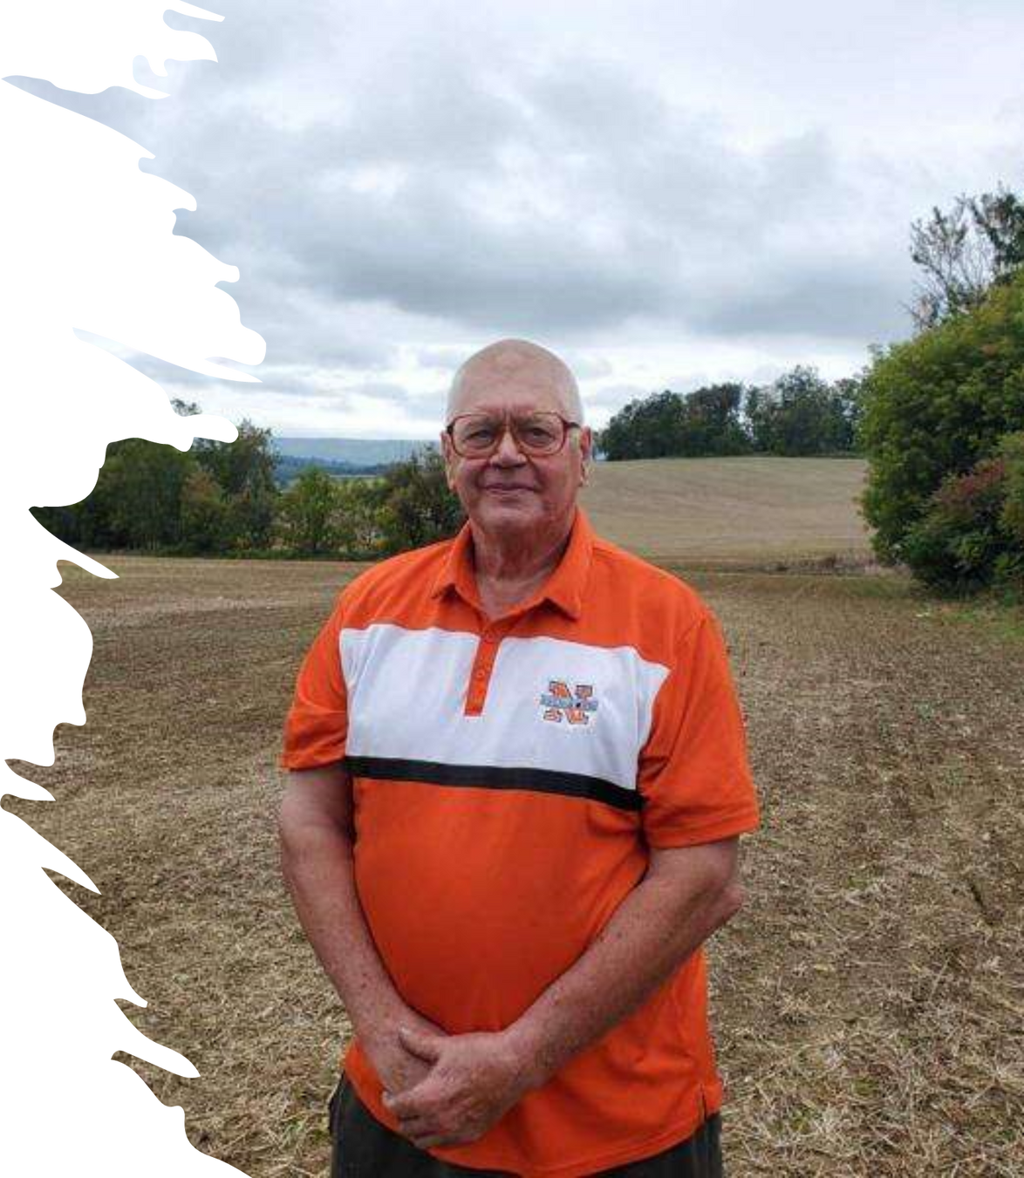
BOARD MEMBERSHP

Slide 19
BOARD MEMBER
BASICS
Basic qualifications
Age: At least 24 years old.
Citizenship: A citizen of the United States.
Residency: A resident of Missouri for at least one year immediately preceding the election and a resident taxpayer of the specific school district. In urban districts, this is a "voter of the district" instead of a "resident taxpayer".
Tax Status: Not delinquent in paying state income tax, personal property tax, municipal tax, or real property tax.

Slide 20
BOARD MEMBER
BASICS
Additional requirements
Criminal Record:
Not found guilty or pled guilty to a felony or an offense that would be considered a felony in Missouri.
Sex Offender Status:
Not a registered sex offender or required to register as one under Missouri law.
Campaign Finance:
If a candidate in a previous election, they must have filed all required campaign disclosure reports with the Missouri Ethics Commission.
Training requirements
New Member Training: New board members must complete 18.5 hours of orientation and training within their first year.
Refresher Training: Members must complete one hour of refresher training each following term year.

Slide 21
BOARD MEMBER
BASICS
No person shall be a candidate for a member or director of the school board in any school district in this state if such person is or has been convicted of or entered a guilty plea for the offense of assault in the first or second degree under section 565.050 or 565.052 or of the offense of harassment in the first or second degree under section 565.090 or 565.091 where such assault or harassment occurred on school district grounds.
Any member or director of the school board of any school district who is convicted of or entered a guilty plea for the offense of assault in the first or second degree under section 565.050 or 565.052 or of the offense of harassment in the first or second degree under section 565.090 or 565.091 for an assault or harassment that occurred on school district grounds shall be ineligible to serve as a member or director of a school board of any school district at the conclusion of his or her term of office

Slide 22
MISSOURI’S DIVERSON OF PUBLIC FUNDS TO NONPUBLIC SCHOOLS:
THE MISSOURI EMPOWERMENT SCHOLARSHIP ACCOUNT PROGRAM
“MOSCHOLARS”

Slide 23
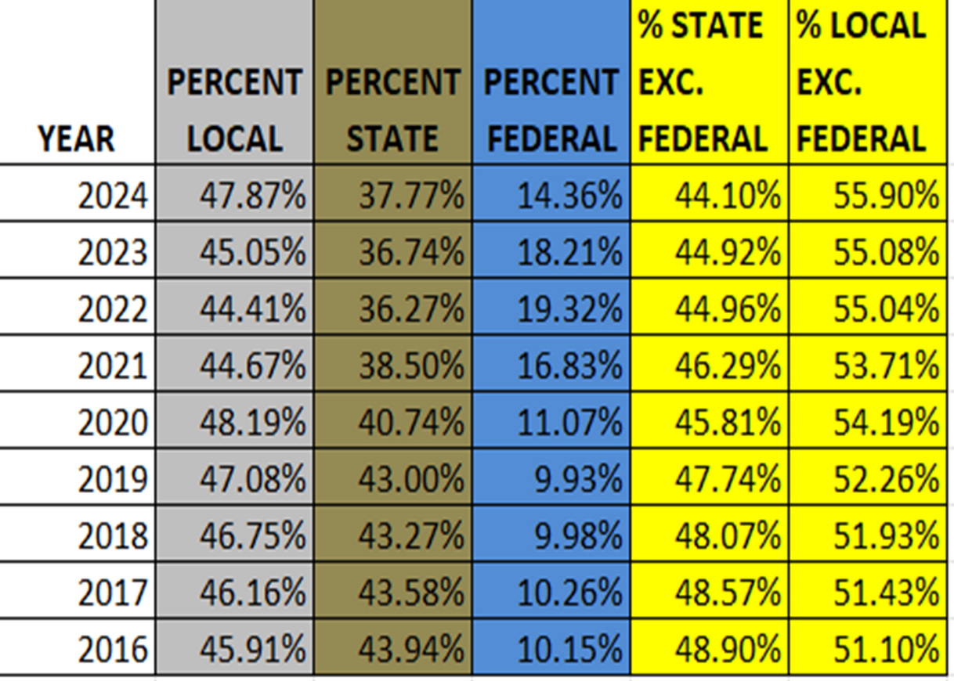
BACKGROUND
Missouri consistently ranks at or near the bottom of all states in the nation when it comes to state funding of public school districts.

Slide 24
BACKGROUND
The State of Missouri consistently ranks at or near the bottom of all states in the nation when it comes to state funding of public school districts.
The State is diverting state funding to private schools, particularly through the MOScholars program, a school voucher program.
Supporters of the voucher expansion say it addresses growing demand for educational alternatives and provides more options for families.
Gov. Kehoe proposed a state budget that:
Did not fund the state adequacy target for 2025-26 fiscal year.
This proposed amount would have shortchanged local public school districts by $300 million.
Provided $50 million in direct taxpayer funding for private school tuition vouchers.
This is the first time Missouri directly used general revenue funds for private school tuition, rather than relying solely on private donations with tax credits.
The budget ultimately provided the $300 million for public schools in exchange for the $50 million the Governor demanded for private schools.

Slide 25
THE MISSOURI EMPOWERMENT SCHOLARSHIP ACCOUNTS PROGRAM
“MOSCHOLARS”
MOScholars is a tax-credit education savings account that allows eligible parents to receive funding to pay for tuition at the school of their choice, as well as other educational expenses such as:
tutoring,
educational therapies,
individual classes, and
extracurricular programs.
Individuals and businesses may receive tax credits for donations to Educational Assistance Organizations (EAOs), nonprofits that administer ESAs
Eligible Students
Students with an IEP (students with disabilities)
Students from “low income” households
“Low income” for purposes of the program is defined as “a household whose total annual income does not exceed an amount equal to three hundred percent of the income standard used to qualify for free and reduced price lunches”.

Slide 26
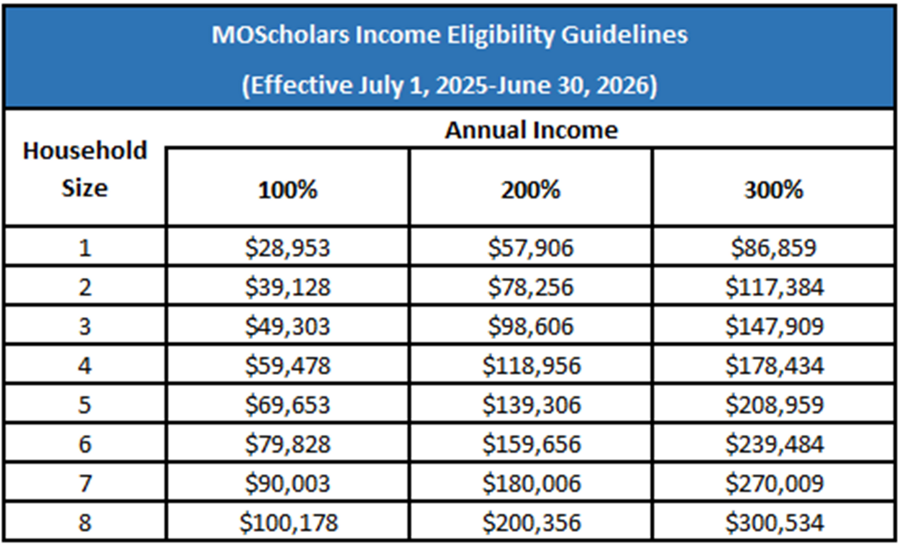

Slide 27
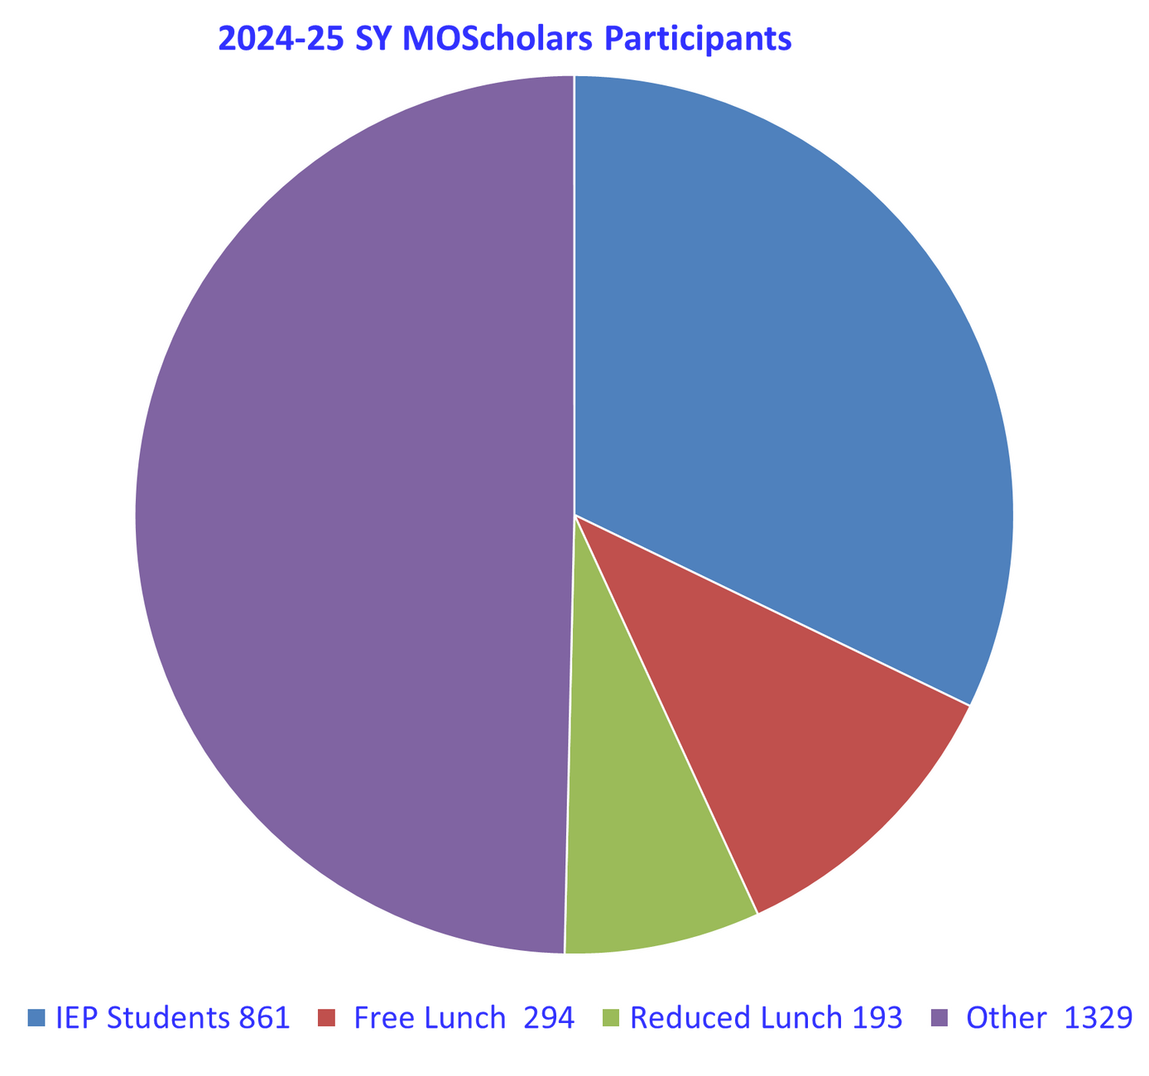
MOSCHOLARS BY
ELIGIBILITY QUALIFICATIONS
IEP 32.16%
Free 10.98%
Reduced 7.21%
Other 49.65%

Slide 28
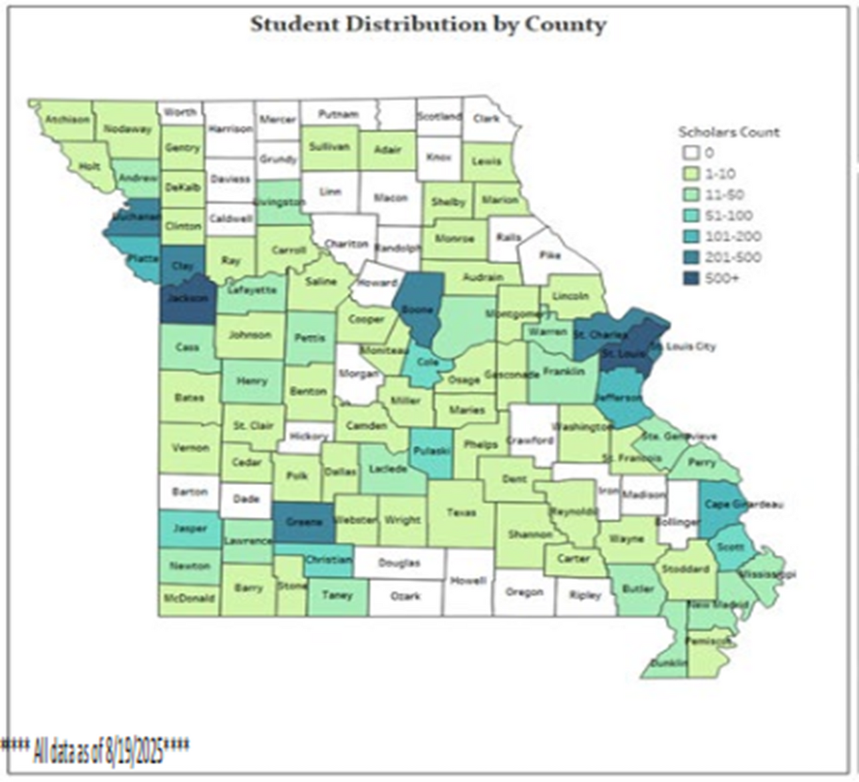
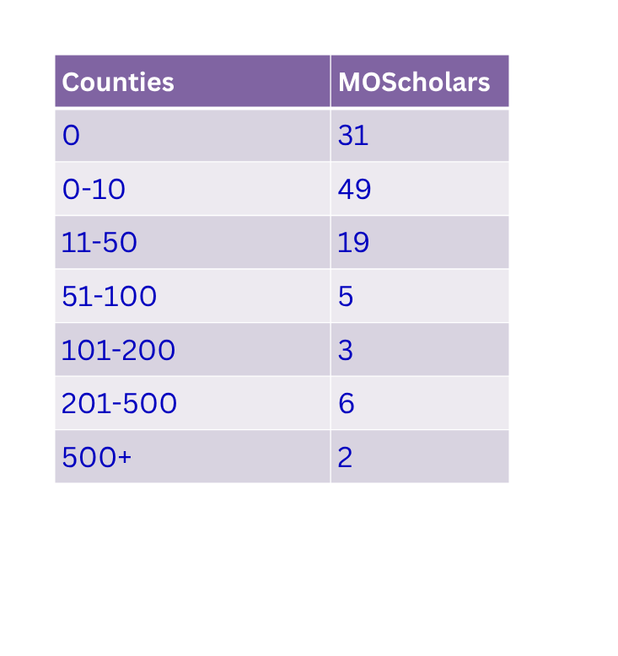
MOSCHOLARS BY
GEOGRAPHICAL DISTRIBUTION FOR 2025-26

Slide 29
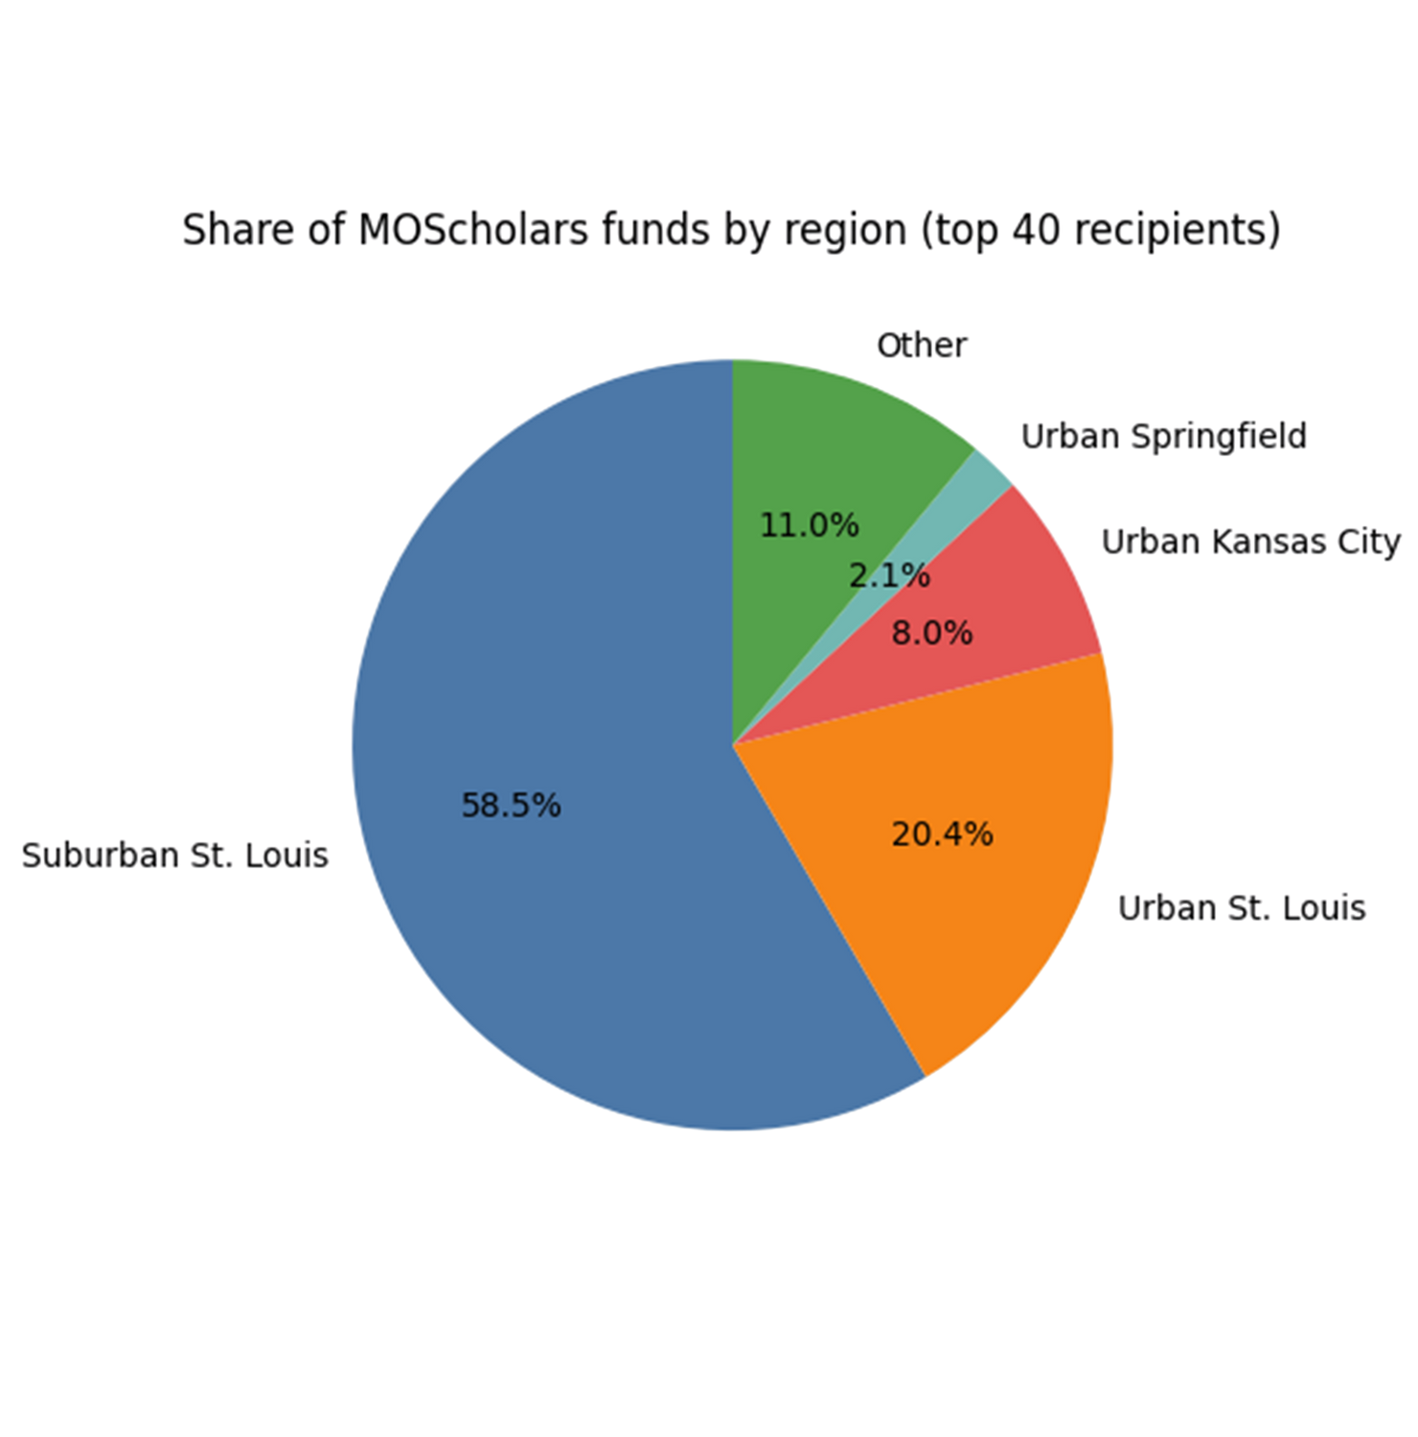
MOSCHOLARS BY
CONCENTRATION IN URBAN AREAS
$39,450,000 in St. Louis Area
$4,000,000 in Kansas City
$1,050,000 Springfield

Slide 30
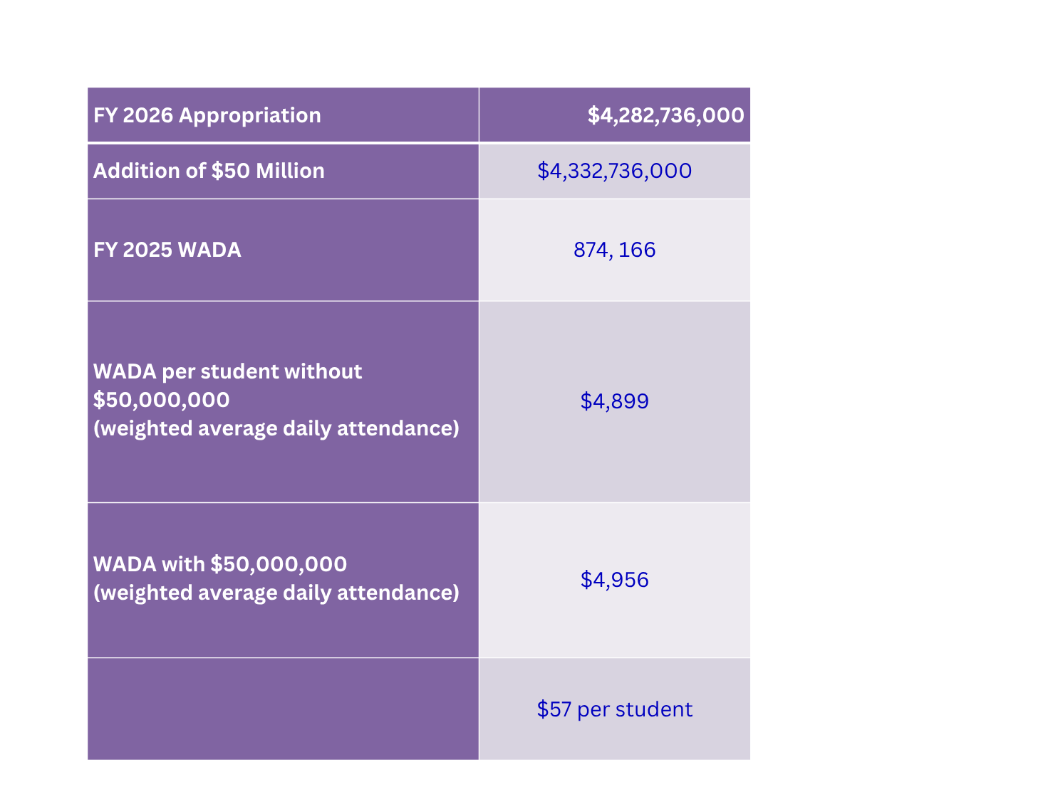
$50 MILLION IN
BASIC FORMULA APPROPRIATION
$57 per student that could have been used in public school districts instead of private schools

Slide 31
NO PUBLIC CONTROL OR
SUPERVISION PERMITTED
The MOScholars statute “shall not be construed to permit any governmental agency to exercise control or supervision over any qualified school in which a qualified student enrolls other than a qualified school that is a public school.” RSMo § 166.720.1
•“A qualified school shall not be required to alter its creed, practices, admissions policy, or curriculum in order to accept students whose parents pay tuition or fees from a Missouri empowerment scholarship account to participate as a qualified school.” .” RSMo § 166.720.3
"Qualified school", an FPE school or any of the following entities that is incorporated in Missouri and that does not discriminate on the basis of race, color, or national origin:
(a) A charter school as defined in section 160.400;
(b) A private school;
(c) A public school as defined in section 160.011; or
(d) A public or private virtual school;
RSMo § 166.700 (8)

Slide 32
PRIVATIZATION OF
EDUCATION IN MISSOURI
The “school choice” advocates believe the role of government in education should be diminished.
School choice advocates believe that, “Elementary and secondary education policy should follow the path outlined by Milton Friedman in 1955, wherein education is publicly funded but education decisions are made by families.”
The path outlined by Friedman is two-tiered concept for education
General education necessary for citizenship
Specialized vocational education
Milton Friedman's role for government in education was limited to funding, not administration, believing this would improve education through market competition.
This approach appears to have gained significant traction and is actively being implemented by the Missouri state government.

Slide 33
PROPOSED
LANGUAGE
(a) Public funds shall not be used in any way that benefits nonpublic schools unless such benefits are equally available to the general public. No person or organization shall receive public aid, directly or indirectly, for educational services provided by a nonpublic school.
(b) Public funds or public aid may, however, be used to pay private individuals or entities for educational or other services to be provided to individuals with disabilities, as defined by law.
(c) The state or a local government may accept federal funds and distribute them to nonpublic schools if no state or local public funds are used to supplement those federal funds.

Slide 34
PROPOSED
LANGUAGE
(d) Definitions. The following definitions apply to this section:
(1) “Public funds” are any funds received or controlled by the state, state agencies, the general assembly, local governments, or any state or local public entity.
(2) “Public aid” includes any form of public financial assistance, benefit, reimbursement, or credit from the state, state agencies, the general assembly, local governments, or any state or local public entity, including but not limited to vouchers, tax credits, education savings accounts, scholarships, or any other form of financial support.
(3) “School” means any institution of learning serving students at any grade level kindergarten through twelfth grade. This definition does not include home schools serving four or fewer children who are not related to one another within the third degree by blood or marriage.
(4) "Nonpublic school” includes any school that provides in person instruction and is not directly controlled by a public school district, a public state university or the state. A public charter school is a nonpublic school unless it was approved by the State Board of Education or a locally elected school board prior to June 30, 2025, or is approved by the voters of the public school district in which the charter school operates and is sponsored by the locally elected school board.

Slide 35
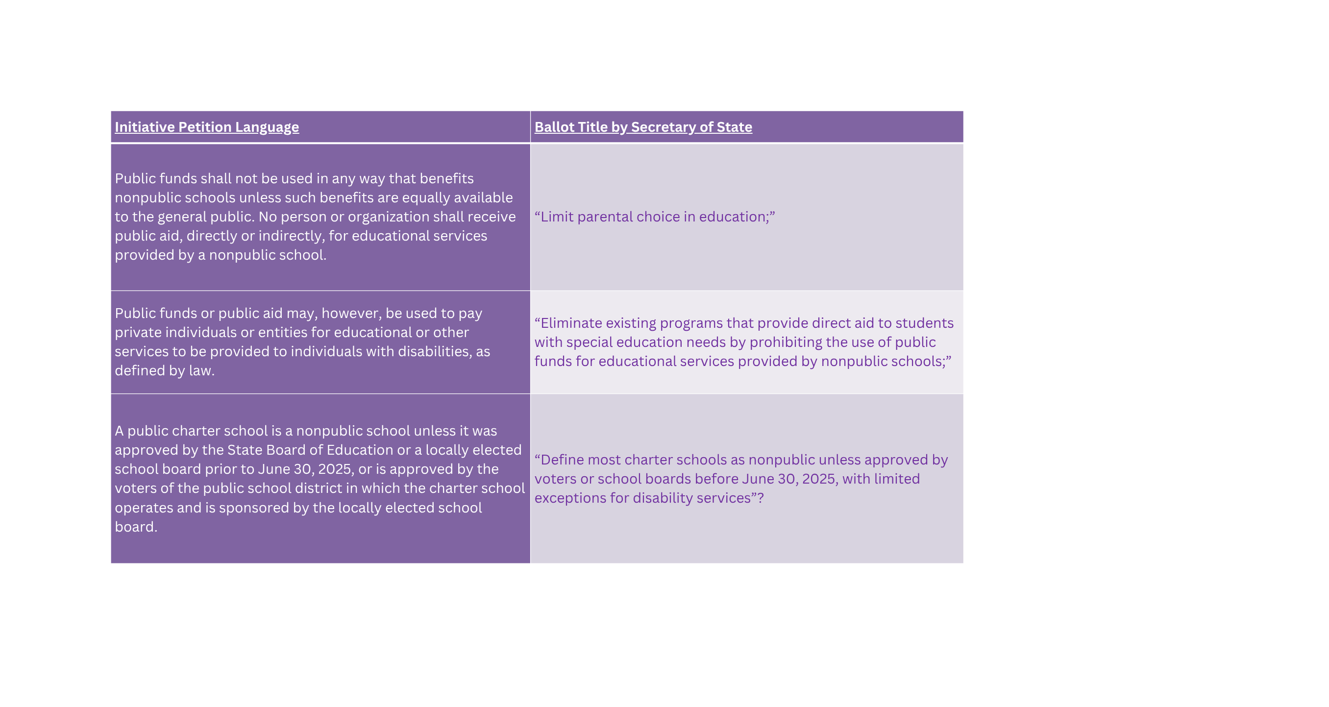

Slide 36






FOLLOW US ON SOCIAL MEDIA
THANK YOU!
EDCOUNSEL INSIGHTS

