Slide 1

Happy
Missouri
Day

Slide 2


Four-Day School Week
A Strategy to Recruit and Retain High Qualify Teachers
Missouri Rural Schools Explore A New School Calendar
Dr. Jon Scott Turner, Associate Professor

Slide 3
Historic Context of the Four-Day School Week
Four-day school week was fairly common historically
During the 20th Century as education standards became more rigorous the four-day school week became relatively rare
During The Great Depression many schools used the four-day school week for a short period of time
During the 1970’s Arab Oil Embargo—again short-term resurgence
Over last 15 years Hawaii and Utah have both implemented large scale implementation due to state budget issues
Historically focused in the rural western states

Slide 4
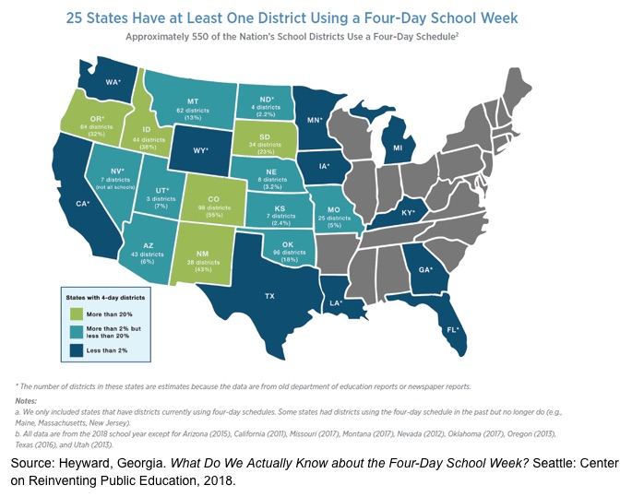

Slide 5
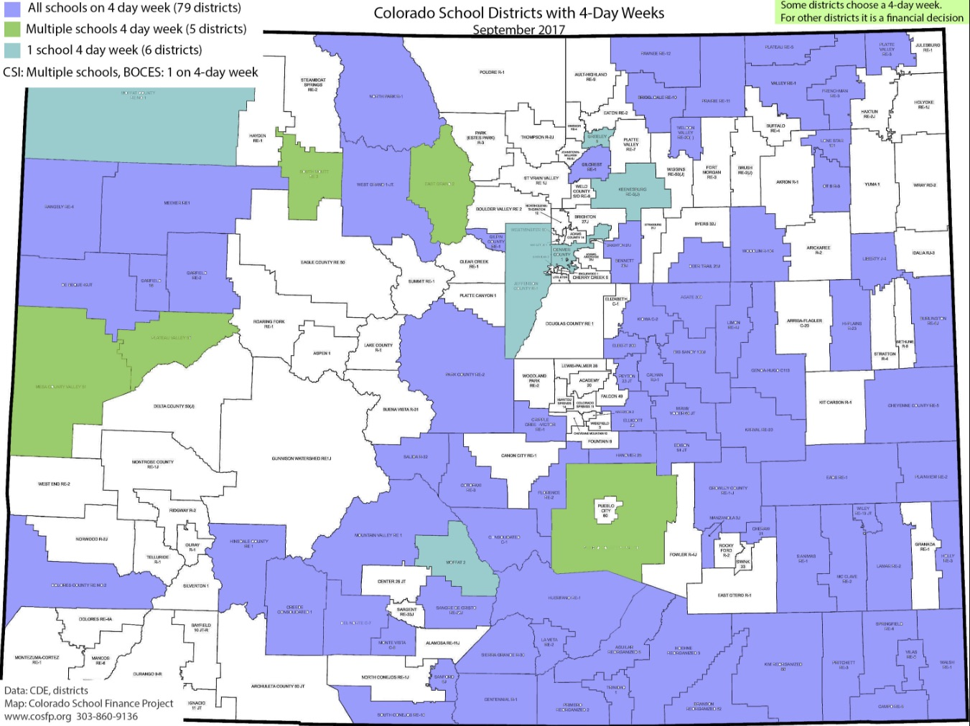
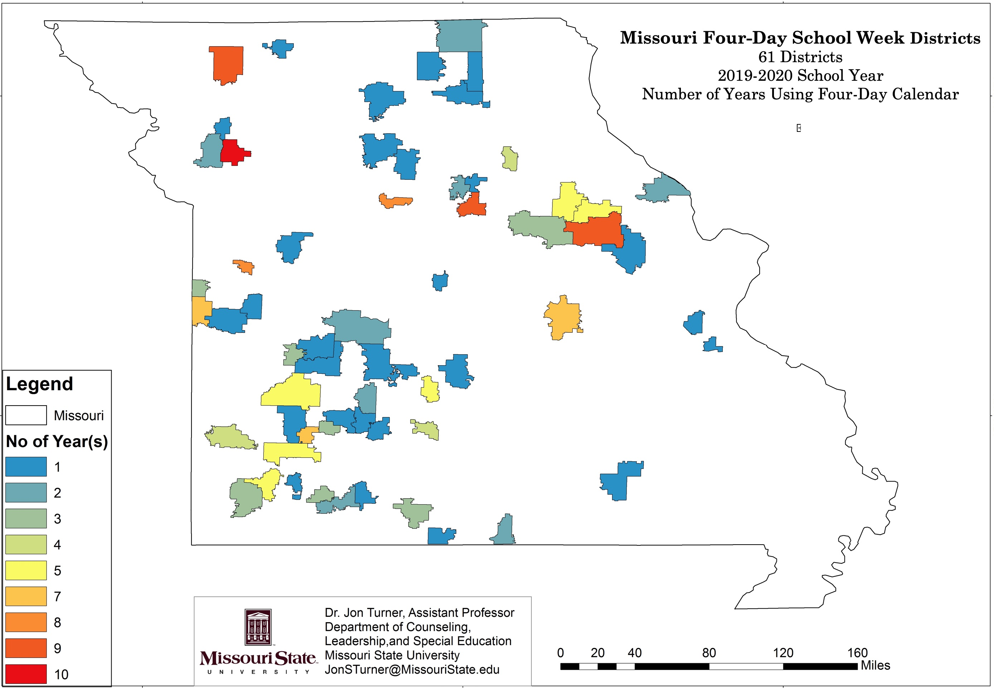
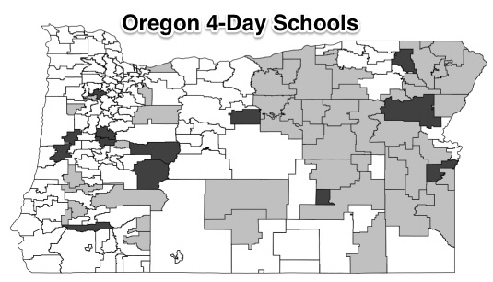
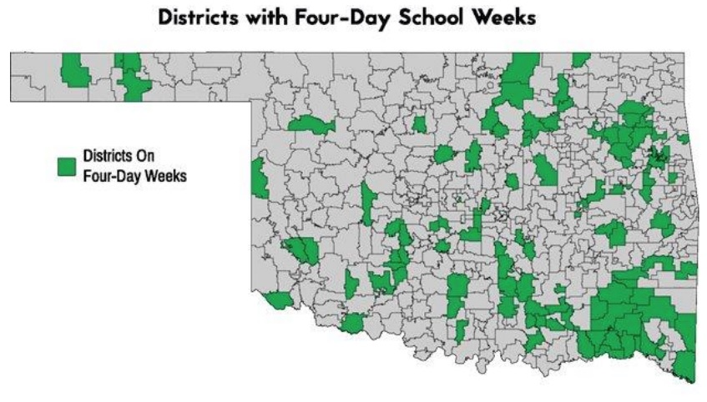
Almost all
4 day school districts are in rural areas

Slide 6
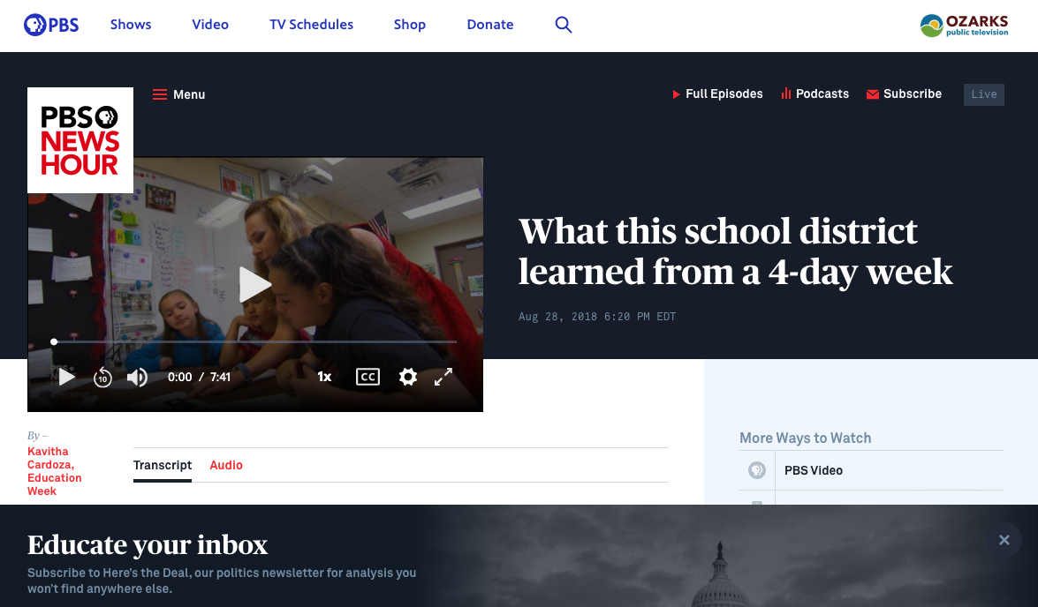
PBS News Hour August 28, 2018

Slide 7
Missouri Has Maintained Small Rural School Districts
518 public school districts
448 School Districts with High Schools
Strong tradition of “Local Control” by local school boards
Median School District Size of all school districts is 585 students
106 Missouri Public Schools have a K-12 enrollment of less than 200 students
63% of school districts have a K-12 enrollment of less than 800 students (12.5% of statewide students)
Only 20 Missouri school districts have K-12 enrollment of more than 10,000 students

Slide 8
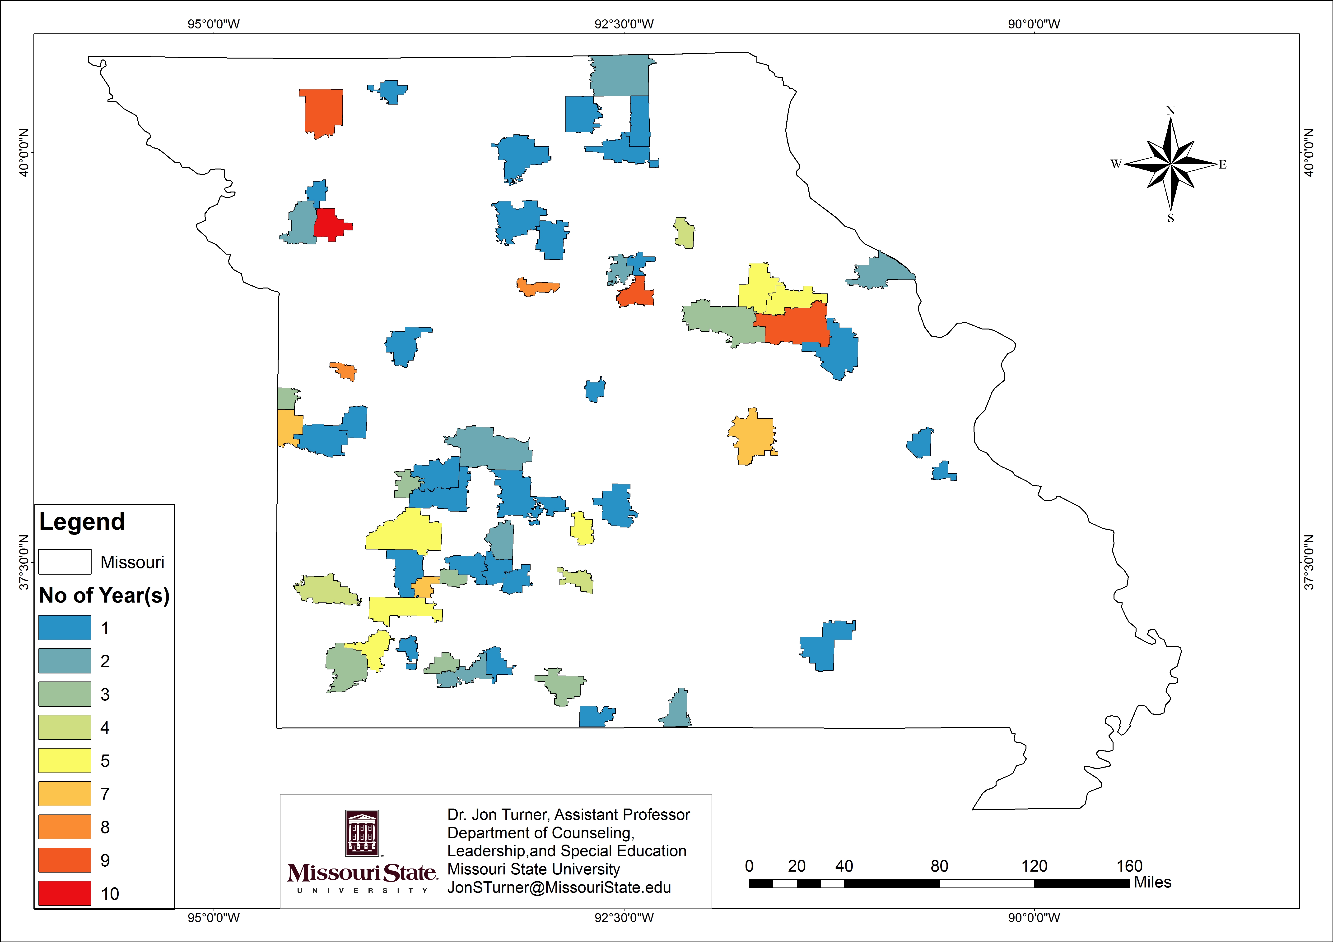
Growing Trend of 4-Day Week in Missouri
2015-2016 12 school districts
2016-2017 17 school districts
2017-2018 25 school districts
2018-2019 33 school districts
2019-2020 61 school districts
2020-2021 105 school districts (20 % of schools)

Slide 9
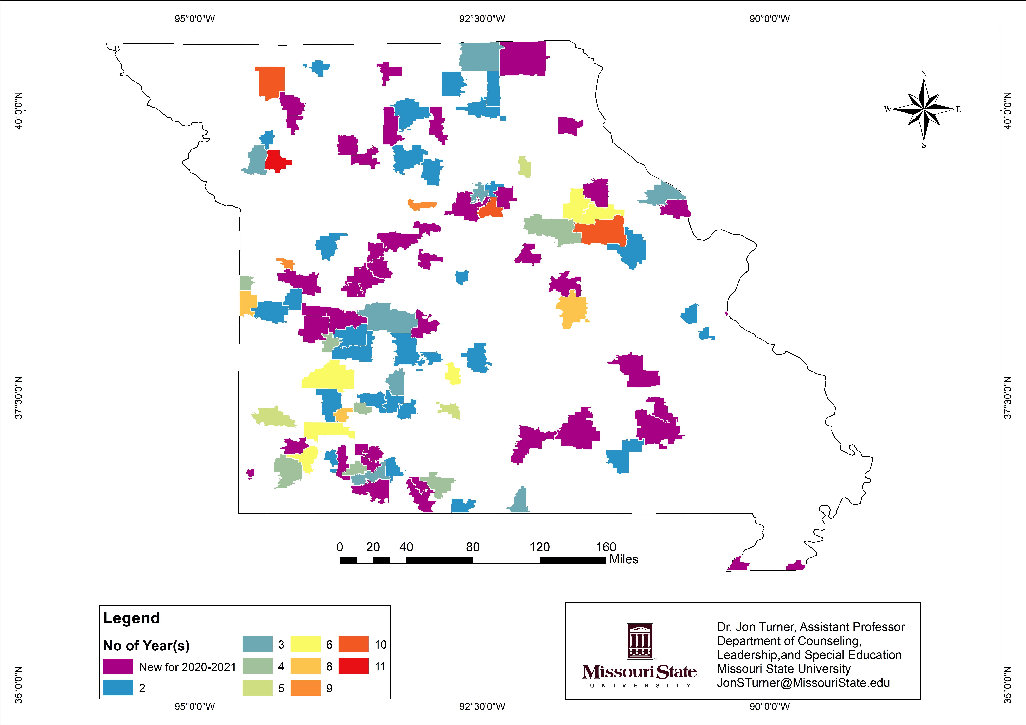
Missouri Four-Day Schools Districts
2020-2021
105 School Districts using 4 day week
44 new schools this year
Only 9 have more than 1,000 students grades K-12
One district over 3,000 students
8 districts have less than 100 students
First became an option in Missouri in 2009 (11th year)

Slide 10
Four-Day School Week-
No Clear Impact on Academic Performance
Mixed results on academic performance
Some research indicates some minor impact one way or the other
Some research indicates impact on academic achievement may be short term—and long-term impact seems to be neutral
Other variables like the quality of teaching probably have a larger impact on academic performance

Slide 11
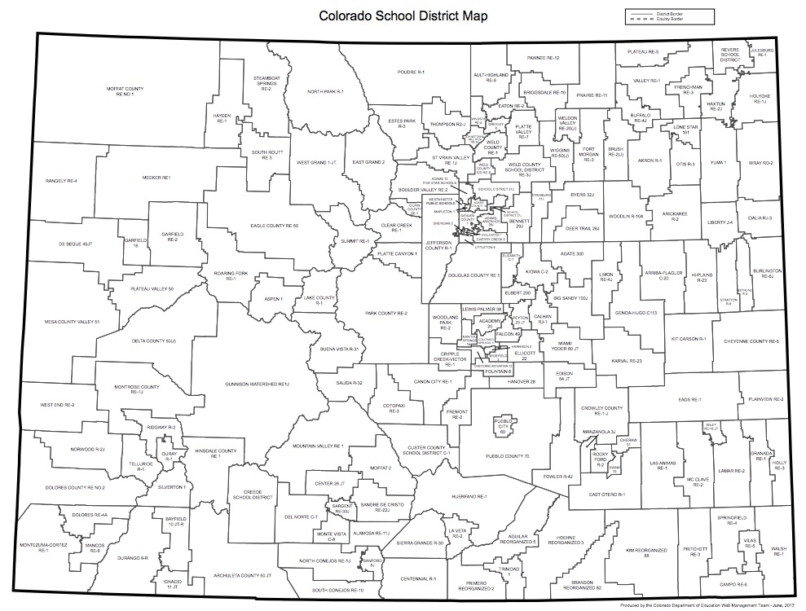
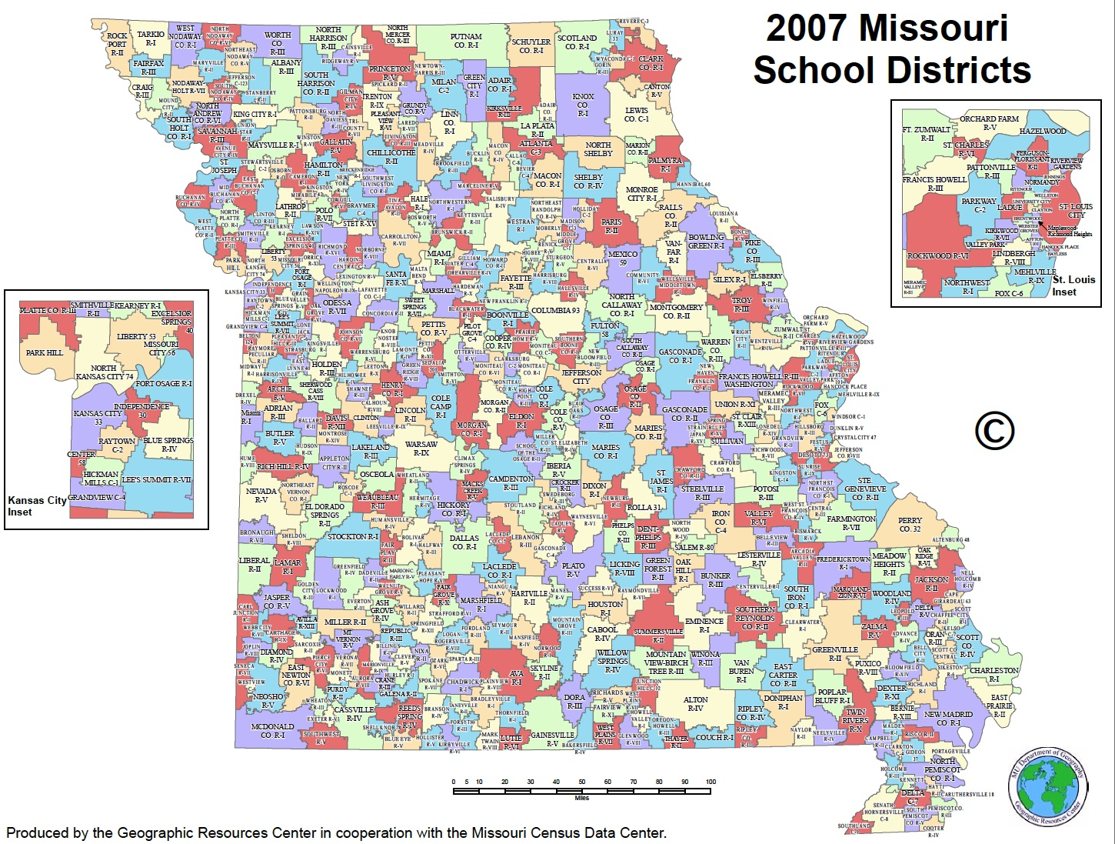
Why look at Missouri’s use of four-day school week?
Local context is important
Colorado
263 public school districts
over 104,185 square miles
Missouri
518 public school districts
over 69,714 square miles

Slide 12
Parent Perspectives: Our results did not support these commonly cited concerns of parents
Few parents expressed concern for their child’s safety during the extra day out of school
Few parents expressed concern about the ability to find childcare during the extra day out of school (two important groups did express concerns)
Few parents expressed concern about the loss of free or reduced lunches (even families who received this benefit)
Single parent households did not show a significant difference in opinion of the four-day school week

Slide 13
Overall Parental Perceptions
68.9% of families supported using the four-day school week in the future
80.5% of families felt their children were as successful in school with the four-day week as they had been the previous year on a traditional calendar
73.1% of families felt that the four-day school week had had a “positive impact” on their family
32.7 % of families felt the four-day school week had “improved public opinion of the quality” of the school district----22.5% disagreed---44.9% neutral/no impact

Slide 14
Overall Parental Opinion
54.8% of ”elementary only” parents wanted to continue with the four-day school week
67.8% of parents with only middle school or high school students wanted to continue
78.65% of parents with both elementary and upper grades students wanted to continue with the four-day school week

Slide 15
Where parental perceptions significantly differ
Parents with only elementary aged children are less supportive of the four-day school week than others
Parents with only elementary aged children have more concern about finding daycare as compared with others (25.6%)
Parent with students receiving special education services were less supportive than other parents. 33% wanted to return to the five-day week as compared to 12% of other families
29.4% of parents with special education students felt the four-day week had not had a positive impact on their family, only 10.1% of other families had this negative impression
Families receiving free and reduced lunches were less likely to feel their child had been as successful in school with a four-day week

Slide 16
Why Missouri administrators are switching to a four-day school week?
Most commonly mentioned reason BY FAR—1st -Teacher recruitment and retention (can’t match salaries or benefits of larger districts)
2nd-Additional collaboration and professional development time
3rd-Attendance of students and teachers
Only four of the 33 four-day school week districts in Missouri (2018-2019) schools mention cost savings as an “important reason” they switched to the four-day school week

Slide 17
Faculty and Staff Findings
Overwhelming support from both certified and classified staff (even staff that report earning less money)
No significant difference between faculty and staff with students enrolled in school

Slide 18
Suggestions from Faculty/Staff
Increased planning and grading time---
  Does require curricular change---focus on the “essential”
  Professional Development must be planned for the change
  Must still provide independent time for teachers on “no student” contract days
Impact on community
  Prepare community for the change (negative people tend to be the most vocal)
  “We took for granted that our community would support this and then tried to play damage control”
Need for extensive prior research---looking for best practices

Slide 19
What changes for teachers with four-day week?
Obviously fewer “teaching days”— but additional professional development days
  about half of the teachers come in two days less a month. (2 PD day per month)
  about 40% come in three less days a month. (1 PD day per month)
On average, in Missouri the length of the teaching day increased 27 minutes (Missouri only monitors instructional hours-minimum 1,044 hours)
On average, the amount of annual Professional Development time triples. Some school establish graduate programs for off days.
Many schools shift from “sick days” to “sick hours” for faculty

Slide 20
Community/Business Leaders Perceptions
Response from 71 community business leaders in the three school districts
Focus on economic impact of the switch on their business and the community, perception of the quality of the school district, and overall support of the model
Overall, perception of community/business leaders was polarizing and evenly split between supportive and not supportive (few were neutral)
Key driver was that community/business leaders with students in school were supportive while those without children in school were not supportive of the four-day week
Would you like to return to a 5 day week? 44% Yes---43% No---13% Neutral

Slide 21
Superintendent Interviews
All report many more applicants for positions
Unexpected Consequences Repeatedly Mentioned
  Expected more recent college graduate applications---surprised by the large number of veteran teacher applications. May have contributed to less $ savings than expected.
  Unexpectedly, hired spouse teachers from other districts to come to their district
  Disappointed by the number of teacher absences—although nearly all said teachers missed school less often but didn’t reduce the number of absences as much as expected
  Mood, engagement, and morale during professional development days
  Fewer retirees at year 30 (typical retirement year in Missouri)

Slide 22
Contact information
Jon S. Turner, Ed.D.
Missouri State University
901 South National Ave
Park Central Office Building 133
Springfield, Missouri 65897
417-836-6518
JonSTurner@MissouriState.edu
Twitter @JonTurnerEdD
https://education.missouristate.edu/CLSE/JonSTurner.aspx

Slide 23
Resources
www.fourdayweek.us

